Slide 1

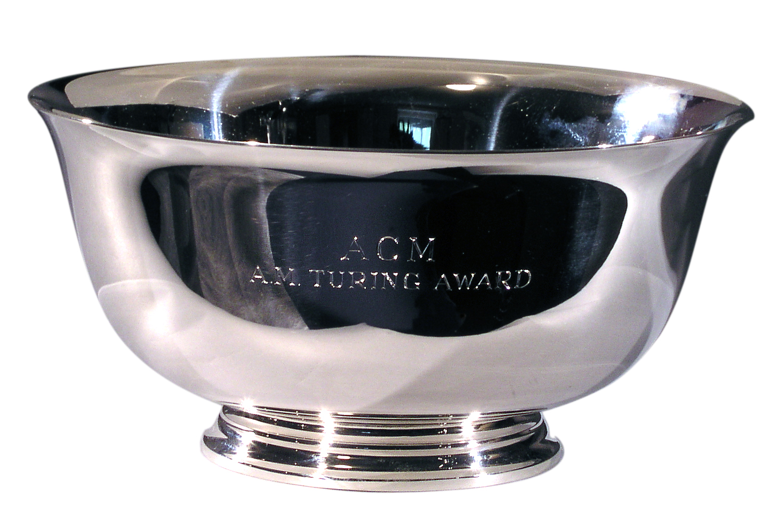
Research Methods Presentation – “A Turning Award Winner”.
By Stephen Gallagher
By Jack Haugh

Slide 2


Beginning Of A.I.

Slide 3

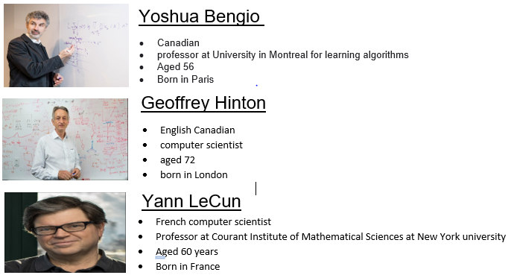
Turing award Winners 2019
Given to those who contributed “ lasting and major technical importance to the computer field".

Slide 4

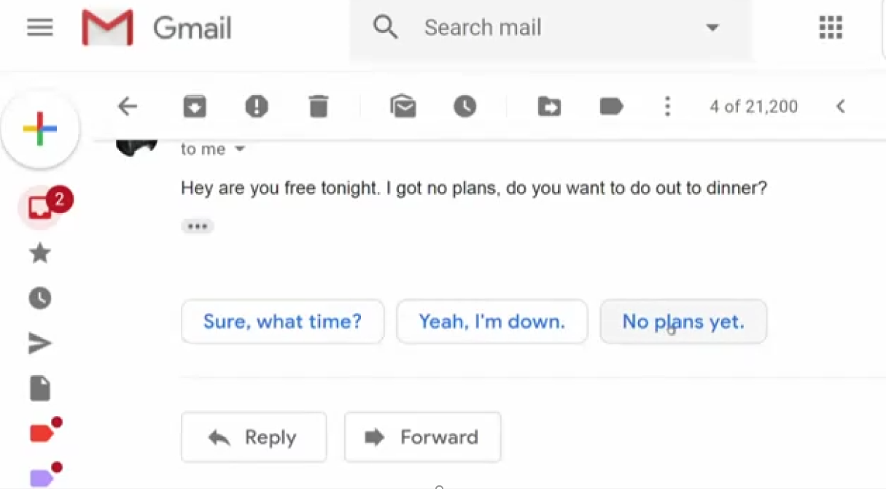
AI EXAMPLE

Slide 5

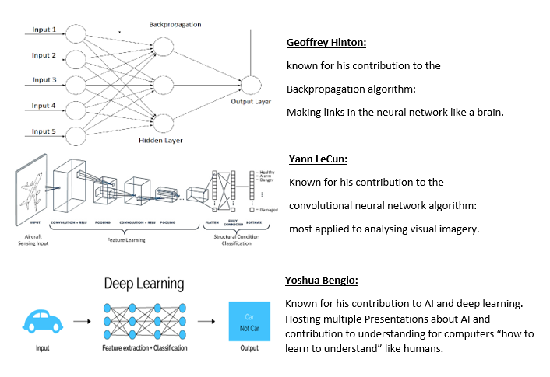
Each Scientists Contribution

Slide 6

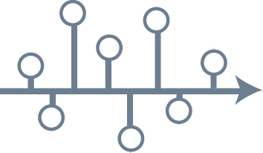
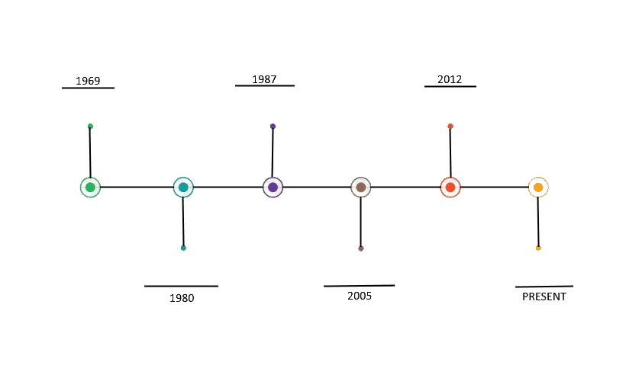
The Turing award winners Timeline

Slide 7

References/Links
https://www.iro.umontreal.ca/~vincentp/ift3395/lectures/backprop_old.pdf
https://s3.us-east-2.amazonaws.com/hkg-website-assets/static/pages/files/DeepLearning.pdf
https://www.researchgate.net/profile/Yann_Lecun/publication/2453996_Convolutional_Networks_for_Images_Speech_and_Time-Series/links/0deec519dfa2325502000000.pdf
Y. Lecun, L. Bottou, Y. Bengio and P. Haffner, "Gradient-based learning applied to document recognition," in Proceedings of the IEEE, vol. 86, no. 11, pp. 2278-2324, Nov. 1998, doi: 10.1109/5.726791.
https://amturing.acm.org/award_winners/lecun_6017366.cfm
https://amturing.acm.org/award_winners/hinton_4791679.cfm
https://amturing.acm.org/award_winners/bengio_3406375.cfm

Slide 8

Any Questions?

